Slide 1
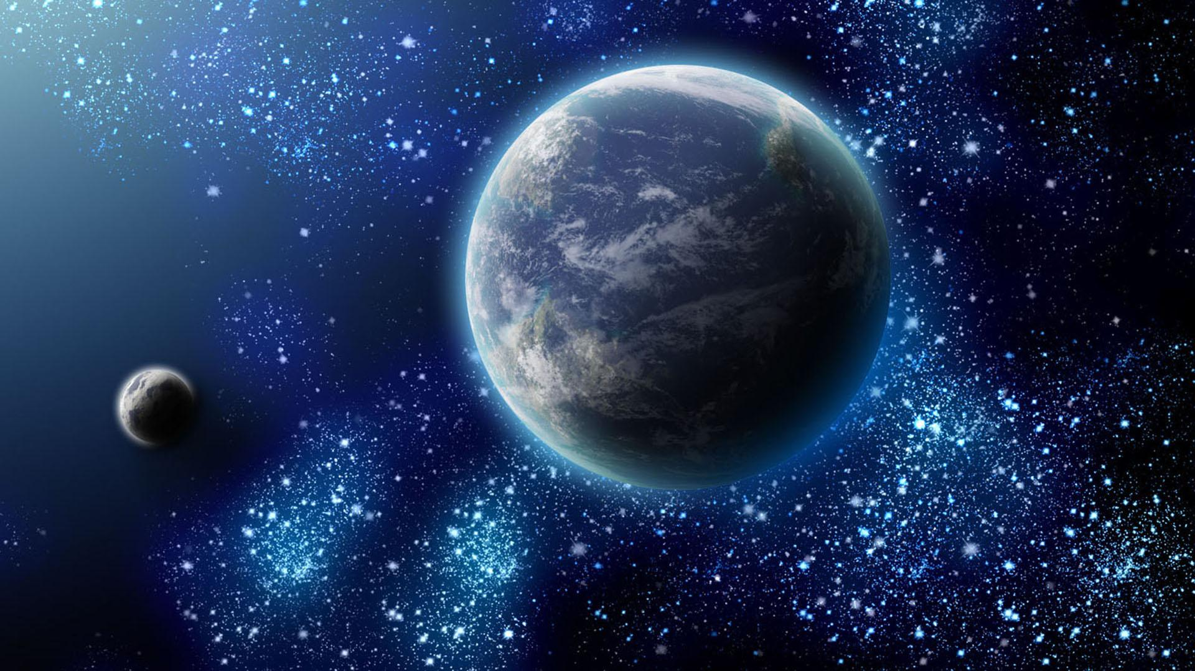
Wittgenstein’s World

Slide 2
My considerations in this talk are part of a larger undertaking which I call the Wittgenstein project.
In order to fit into my given timeframe I have condensed my presentation.
You can find a fuller version of it as well as other materials on the Wittgenstein project on my website and the accompanying blog:
www.truthandpower.com

Slide 3
I begin my discussion by looking once more at the first sentence of the Tractatus and reflecting specifically on the subject-term of that sentence.
My intention is to understand the Tractatus as being significantly a treatise about the world – not just a work on logic, language, or meaning or the nature of facts and objects.
“The world is everything that is the case.” (TLP, 1)
“Die Welt ist alles, was der Fall ist.”

Slide 4
The term “world” occurs, in fact, 43 times in the Tractatus – which is a remarkable number given the shortness of the work.
Wittgenstein had also already talked repeatedly about the world in his Notebooks 1914-1918 from which he extracted the Tractatus.
And the term also plays a decisive role in Wittgenstein’s “Lecture on Ethics” of 1929.

Slide 5
Despite this, interpreters have paid little attention to this central term and to Wittgenstein’s concern with the world in the Tractatus.
That may be due to Wittgenstein’s later explicit dismissal of the term as being of no philosophical interest.
In February 1933, G. E. Moore recorded him as saying in his lectures:

Slide 6
„This [Tractarian] idea of one calculus is connected with [the] consequence that certain words are on a different level from others, e.g., ‘proposition’, ‘world’, ‘word’, ‘grammar, ‘logic’. I had the idea … that certain words were essentially philosophical words ... But it’s not the case that those words have a different position from the others. E.g., I could now just as well start [the] Tractatus with a sentence in which ‘lamp’ occurs, instead of ‘world’.”
Wittgenstein Lectures, Cambridge 1930-1933. From the Notes of G.E. Moore, edited by David G. Stern, Brian Rogers, and Gabriel Citron, Cambridge University Press, Cambridge 2016, pp. 259-260.

Slide 7
„This [Tractarian] idea of one calculus is connected with [the] consequence that certain words are on a different level from others, e.g., ‘proposition’, ‘world’, ‘word’, ‘grammar, ‘logic’. I had the idea … that certain words were essentially philosophical words ... But it’s not the case that those words have a different position from the others. E.g., I could now just as well start [the] Tractatus with a sentence in which ‘lamp’ occurs, instead of ‘world’.”
Wittgenstein Lectures, Cambridge 1930-1933. From the Notes of G.E. Moore, edited by David G. Stern, Brian Rogers, and Gabriel Citron, Cambridge University Press, Cambridge 2016, pp. 259-260.

Slide 8
A few months later he reaffirmed this thought in the same lecture course: “The words ‘meaning‘, ‚proposition‘, ‚world‘ have no special place in our investigation.”
(Ibid., p. 317)
And this critical view is also retained in Wittgenstein’s Philosophical Investigations where we read:
“If the words ‘language’, ‘experience’, ‘world’ have a use, it must be as humble a one as that of the words ‘table’, ‘lamp’, ‘door’.”
(PI, 97)

Slide 9
Interpreters of Wittgenstein have concluded this to mean that we should not concern ourselves with the world at all, and focus exclusively on specific and narrowly circumscribed philosophical questions.
In looking at the Tractatus once more, we can come to see that this is not what Wittgenstein was after.
To understand this point we must pay attention to two different ways in which the world appears in that work.

Slide 10
“The world is everything that is the case.” (TLP, 1)
“Die Welt is alles, was der Fall ist.”
.
.
.
.
.
“My propositions serve as elucidations in the following way: anyone who understands me eventually recognizes them as nonsensical…. He must transcend these propositions, and then he will see the world aright.” (TLP, 6.54)
“Er muss diese Sätze überwinden,
dann sieht er die Welt richtig.”

Slide 11
Wittgenstein argues at the end of the Tractatus that in any so-called metaphysical “proposition” we have “failed to give a meaning to certain signs.” (TLP 6.53)
The first sentence of the Tractatus is clearly an example of such a metaphysical proposition. The expression “all that is the case” has, in fact, no logically viable meaning. Since the term “world” is explained by means of this expression in TLP, 1, it, too, has no logically viable meaning.
It follows that the first sentence of the Tractatus as a whole has also no meaning.

Slide 12
This is, however, not yet the end of the story. For, according to Wittgenstein’s own words, once we have come to understand that the first sentence of the Tracatus is nonsensical we will be in a position (and only then will we be in a position) to see the world in the right way.
My propositions serve as elucidations in the following way: anyone who understands me eventually recognizes them as nonsensical…. He must transcend these propositions, and then he will see the world aright.” (TLP, 6.54)
“Er muss diese Sätze überwinden,
dann sieht er die Welt richtig.”

Slide 13
In considering the first sentence of the Tractatus, our most pressing concern is, however, not with its problematic content but with its placement.
How can a philosophical text begin with an apodictic statement about the world as a whole? Doesn’t philosophy have to begin with a doubt or a question and then finally, if at all, work itself forward to a conclusion about the world as a whole?
That is, in fact, the order of reasoning that Descartes has adopted in his Meditations on First Philosophy. But Wittgenstein reverses this Cartesian order. He begins with an apparently apodictic assertion about the world and ends with a doubt about whether his propositions have sense.

Slide 14
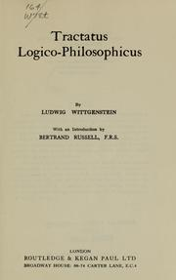
The forerunner to this anti-Cartesian turn in philosophy is to be found in Arthur Schopenhauer’s main philosophical work, The World as Will and Representation.

Slide 15
Schopenhauer’s work had been published a century before the Tractatus.
But his book had gained a new set of readers in fin-de-siecle Vienna and it is said to have been the first book in philosophy that Wittgenstein read.
Both The World as Will and Representation and the Tractatus are works written by young men. They share the ambition to turn the philosophical tradition upside-down and replace it with a radically new treatment of the subject.

Slide 16
The beginning and end of the two works correspond closely to each other.
“The world is everything that is the case.” “My propositions serve as elucidations in the following way: anyone who understands me eventually recognizes them as nonsensical…. He must transcend these propositions, and then he will see the world aright.” | “The world is my representation.” “We freely acknowledge that what remains after the complete abolition of the will is, for all those in whom the will has turned and denied itself, this very real world of ours with all its suns and galaxies, is – nothing.”

Slide 17
There are, naturally, significant differences between the way Wittgenstein and Schopenhauer speak about the world:
For Wittgenstein the world is a totality of (objective) facts,
whereas for Schopenhauer it is (subjective) representation.
And where Wittgenstein speaks at the end of seeing the world in the right way, Schopenhauer seeks to transcend the world through a quieting of the will.
But their relation is, in fact, more complex than that.

Slide 18
A quick look at Schopenhauer’s work will help us further.
The book describes four stages of development that lead from the common sense view of the world to the realization that for the truly enlightened person the world loses its significance and, in this sense, becomes nothing.
Book 1: The common sense view of things
Book 2: Metaphysics. “The world as will and representation.”
Book 3: Art as a form of detachment
Book 4: Ethics and mystical transcendence
Note that metaphysics occupies only the second stage of development and is meant to be overcome first in art and then through ethical transcendence.

Slide 19
We can read the Tractatus as describing a similar course of development that leads from the affirmation of a metaphysics to the transcending of that metaphysics in the act of seeing the world aright.
For both Schopenhauer and Wittgenstein, this development takes us from a set of theoretical beliefs about the world to the ethically right way of seeing the world and relating to it.
The overcoming of our metaphysical claims about the world allows us finally to see the world in the right way and provides us with the right ethical attitude towards the world.

Slide 20
The course of thinking in the Tractatus and in The World as Will and Representation follows, thus, corresponding steps.
TLP 1-2.062
The world of facts and objects
TLP 2.063-6.422
The logic of representation
TLP 6.4
“Aesthetics and ethics are one.”
Ethics, the mystical
TLP 6.53-7
Transcendence and silence
Book 1: The common sense view of things
Book 2: Metaphysics. “The world as will and representation.”
Book 3: Art as a form of detachment
Book 4: Ethics and mystical transcendence

Slide 21
Both Schopenhauer and Wittgenstein insist on a non-prescriptive view of ethics.
Schopenhauer writes of his own work:
“In this ethical book no precepts, no doctrine of duty are to be expected; still less will there be set forth a universal moral principle, a universal recipe, so to speak, for producing all the virtues.” (p. 272)
Characterizing the Kantian categorical imperative as childish, he adds: “Philosophy can never do more than interpret and explain what is present at hand.” (p. 271)

Slide 22
The person who has leaned to interpret the world, Schopenhauer also writes in his book, “knows the whole, comprehends its inner nature, and finds it involved in a constant passing away, a vain striving, an inward conflict, and a continual suffering. Wherever he looks, he sees suffering humanity and the suffering animal world, and a world that passes away” (p. 379)
And with this vision of the world, “man attains to the state of voluntary renunciation, true composure, and complete willlessness.” (Ibid.)
“Here, where there is a question of salvation or damnation, not the dead concepts of philosophy decide the matter, but the innermost nature of man himself.” (p. 271)

Slide 23
To appreciate, how close Wittgenstein’s moral attitudes are to Schopenhauer’s in the period of the First World War, one must turn to remarks in his war-time notebooks and particularly the so-called “Secret Diary.”
After an initial enthusiasm for military service, Wittgenstein’s view of the war had quickly become very dark.
Only “the spirit,” he writes in the Secret Diary, can provide a “safe haven protected and apart from the desperate and infinitely gray ocean of happenings.”

Slide 24
He is convinced that he will not survive the war and may not even live the next day.
So, how is it possible to be “happy” in such a world? Only by living in the moment, by having no wishes and desires, and by overcoming the will in a state of “complete passivity.”
“In order to live happily, I must be in agreement with the world… I am then, so to speak, in agreement with that alien will on which I appear dependent…. Fear in the face of death is the best sign of a false, i.e., bad, life.”

Slide 25
It’s in this spirit that Wittgenstein adds a remark that is repeated in the Tractatus:
“The solution of the problem of life is to be seen in the disappearance of this problem.” (TLP, 6.521)
The solution of the problem of life is, in other words, not found in the possession and use of a set of moral rules.

Slide 26
In the Tractatus, Wittgenstein follows Schopenhauer’s rejection of any form of rule-based ethics:
“All propositions are of equal value… Hence also there can be no ethical propositions. Propositions cannot express anything higher. It is clear that ethics cannot be expressed. Ethics is transcendental… The first thought in setting up an ethical law of the form ‘though shalt…’ is: and what if I do not do it?” (TLP, 6.4-6.422)
This conclusion is prefigured already at the beginning of the Tractatus. The assertion that that the world is the totality of facts hints already at the exclusion of values from the world.

Slide 27
Returning to the first sentence of the Tractatus, we want to ask at this point: What does it mean to say that something is the case (or is “der Fall”)?
Both the English and the original German expression refer to the rolling of dice. The die falls, and something is “der Fall” or “the case”. (“Case” from Latin “casus” derived from “cadere” = to fall)
What is “der Fall” is thus “zufällig”, i.e., contingent.
The first sentence of the Tractatus does not simply state that the world is a totality of facts; it announces that these facts are contingent and that the world as a whole is contingent in its existence.

Slide 28
Wittgenstein makes this point explicitly later on in the Tractatus when he writes:
Ogden: “For all happening and being-so is accidental.”
Pears-McGuinness: “For all that happens and is the case is accidental.”
Better: “For all happening and being-so is contingent.”
“Denn alles Geschehen und So-Sein ist zufällig.” (TLP, 6.41)

Slide 29
“Die Welt is alles, was der Fall ist.” (TLP 1)
……………………
“Denn alles Geschehen und So-Sein ist zufällig.” (TLP 6.41)

Slide 30
The contingency of the world has profound consequences for Wittgenstein.
It means for him that there cannot be any value in the world since, according to him, values cannot be contingent. That is also why there cannot be any ethical propositions.
Value is found rather in our seeing or experiencing the world, in the attitude we have to it.

Slide 31
Wittgenstein reformulates this view in his 1929 “Lecture on Ethics” which abstains likewise from advancing moral rules.
Instead, he speaks in this lecture of three fundamental ethical experiences, three attitudes towards the world and oneself:
A sense of wonder that there is something rather than nothing.
A sense of feeling guilty whatever one has done.
A sense of feeling safe whatever happens.

Slide 32
These three “ethical” experiences transpose, in fact, three fundamental Christian beliefs:
The miracle of the divine creation of the world out of nothing.
Original sin as the fundamental condition of human life.
Salvation: “I know that my redeemer liveth.”
By contrast, Schopenhauer’s fundamental ethical experience is an adaptation of the Buddhist belief in the unity of all suffering beings. (“I am Thou.”)
In this we find perhaps the most revealing difference between Wittgenstein and Schopenhauer.

Slide 33
Far from confining himself to a narrow philosophical focus on particulars, Wittgenstein insists both in the Tractatus and in the “Lecture on Ethics” on what we might call a holistic conception of ethics.
He wants us to reflect on how we come to our picture of the world and how that pictures structures both our theoretical beliefs and our practical commitments.
He writes characteristically in his wartime notebook of 1916:

Slide 34
“This is the way I have travelled: Idealism singles men out from the world as unique, solipsism singles me out alone, and at last I see that I too belong with the rest of the world, and so on the one side nothing is left over, and on the other side, as unique, the world. In this way idealism leads to realism if it is strictly though through.” (17.10,16)
The remark is usually taken to refer to matters of epistemology and ontology, but we can also read it as referring to ethical concerns.
It occurs, in fact, in Wittgenstein’s Notebooks at a time when he is deeply engaged in ethical questions.

Slide 35
Our concern in ethics is most commonly with interpersonal relations.
More broadly, we can distinguish three traditional aspects of ethics:
An ethics of the care of the self (Confucian and Aristotelian virtue ethics)
An ethics of interpersonal relations (the Mosaic Law, the Kantian categorical imperative)
A social and political ethics (Plato, Aristotle, and Rawls on social justice)

Slide 36
But we need, in addition, to attend to a fourth aspect.
A world ethics concerned with our relation to the world as a whole.
Wittgenstein, in conjunction Schopenhauer, shows us that ethics in its broadest sense calls for philosophical reflection on the world, on how we see the world, on what picture we have of it and of our place in it.
It is in such terms that, among other things, an environmental ethics needs to be understood.

Slide 37
“The world is everything that is the case.”
Tractatus, 1
“Light dawns gradually over the whole.”
On Certainty, 141

